Slide 1
A Chess Engine For Generating Game Data To Train Deep Learning Chess Neural Networks
METHODOLOGY PRESENTATION
Ahira Justice, ADEFOKUN
185576
Computer Science

Slide 2
Problem Statement
Training data for deep learning chess engines are rare to come by. Some of these datasets are collated manually from tournaments played by humans and artificial intelligence (AI). These datasets are entered into online repositories for referencing.
Generating the data needed for the “training” of this new breed of “intelligent” game engines automatically, is the focus of this study.

Slide 3
Aim and Objectives
The aim of this project is to build a chess engine that produces data for training neural networks in deep learning chess engines.
The proposed system has the following objectives:
1. To design and model a chess engine that enables AI to AI gaming.
2. To implement a chess engine model that provides data for training deep learning networks based on chess game.

Slide 4
Methodology
System requirement analysis was done with review of literature on chess engines and an examination of the manual existing system.
Design will be done using use case diagram, and activity diagram.
Implementation will be done with the python programming language with plain text data in portable game notation (PGN) as the data output format.
Deployment and Testing would be done on a desktop computer with the command line as its interface.

Slide 5
Existing System
The existing systems, by which a developer of deep learning chess engines could generate data for the training of its neural network is largely a mammoth task of obtaining precomputed data of chess games from online repositories and normalizing or parsing such data into usable formats either by manual means or automated scripting, or both.

Slide 6
Proposed System
The proposed system generates the data required to train the neural networks of deep learning chess engines dynamically as games played, in the moment by two distinct “artificial intelligences” and stored in portable game notation (PGN).
In developing this system, the prototyping paradigm of software engineering will be used.
The proposed system has a client-server architecture, with a command-line interface as the client frontend, and the chess engine as the server backend.

Slide 7
Non-functional Requirements
Performance: The system requires a considerable amount of computational power, as it is very process bound and computationally complex system.
Correctness: The correctness of the game data stored in portable game notation (PGN) depends on the correctness of each stored move.

Slide 8
Non-functional Requirements
Hardware Requirements
Recommended specifications
Processor Intel® Core™ i7-7700HQ processor Quad-core 2.80GHz
Memory 16 GB DDR4 RAM Memory
Software Requirements
Windows 7, 8, 8.1, 10
Python 3.x

Slide 9
Functional Requirements
A user shall be able to tell the system how many games they want computed.
A user shall be able to tell the system what artificial intelligences will play the specified games.
A user shall be able to extend the system and implement their own artificial intelligences.
A user shall be able to access the data of computed games in portable game notation (PGN) format.

Slide 10
Functional Requirements
The system shall be able to receive input specifying the number of games to be played, and validate the correctness of this input.
The system shall be able to receive input stating the artificial intelligences that will play the specified number of games, and validate the correctness of this input.
The system will play the specified amount of games and produce the data of those games in portable game notation (PGN) format.

Slide 11
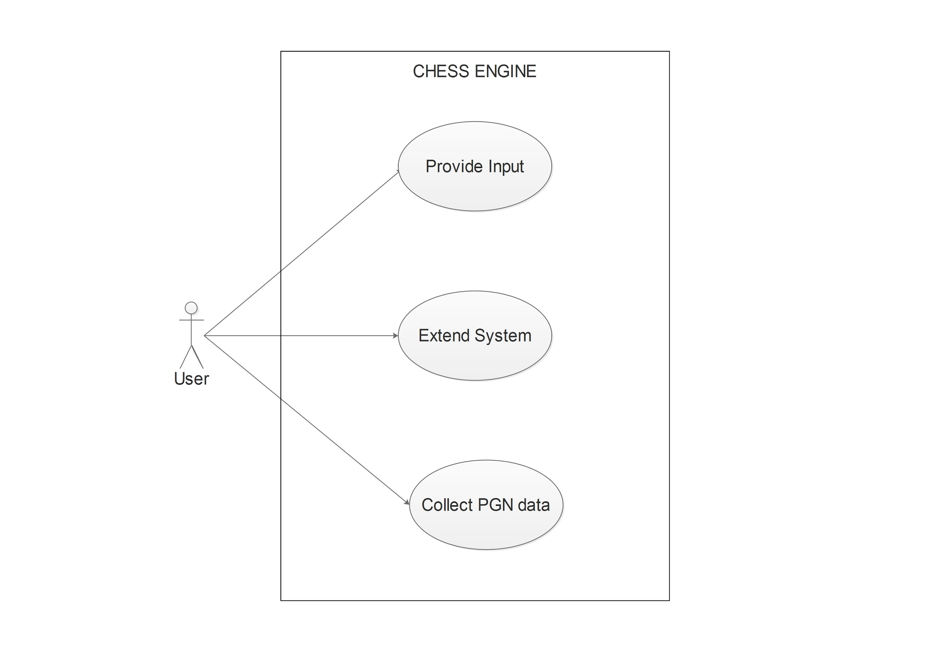
Use Case Diagram

Slide 12
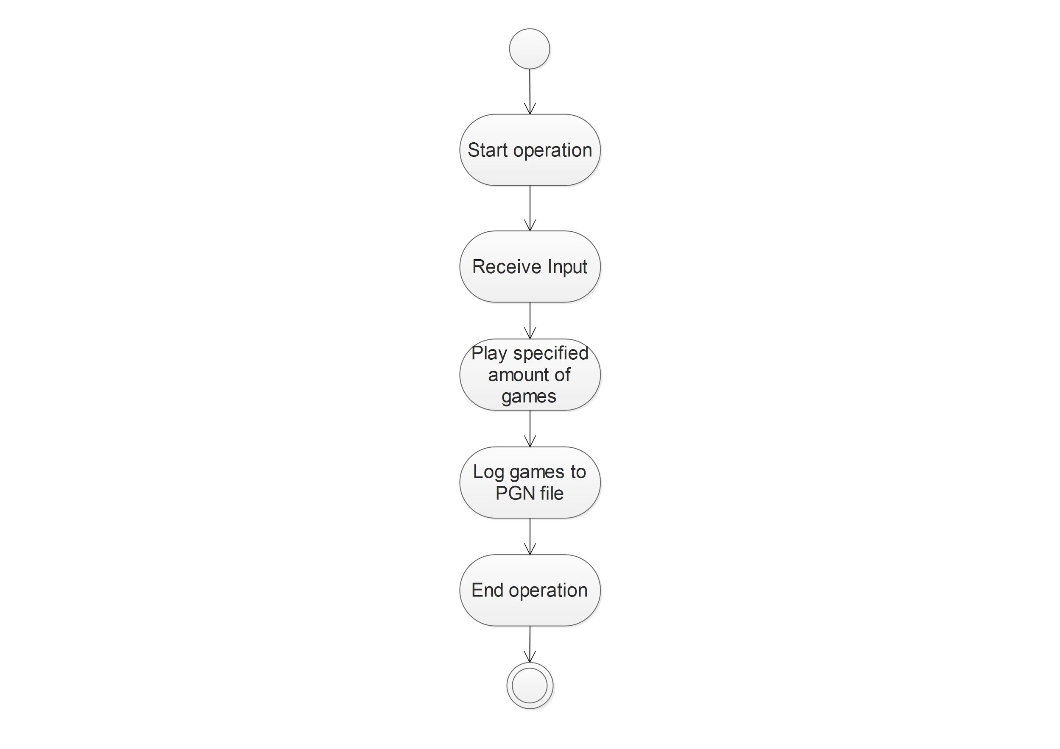
Activity Diagram

